Slide 1
What to do with my old Textbooks?

Slide 2
Current Offerings
College Book Store
Pros:
-Quick and easy process
Cons:
-Lose a lot of money when selling
-Pay a lot of money when buying
eBay & Craigslist
Pros:
-Buy cheaper and sell at higher price
-Done right from computer
Cons:
-Need to create account
-Slow process that requires personal information

Slide 3
Laker Books

Slide 4
Features
Quick and simple process
No need enter personal and sensitive information
No middleman so more savings for everyone
Done right from computer
Only need to access website once
No registration
Can be used on a variety of devices

Slide 5
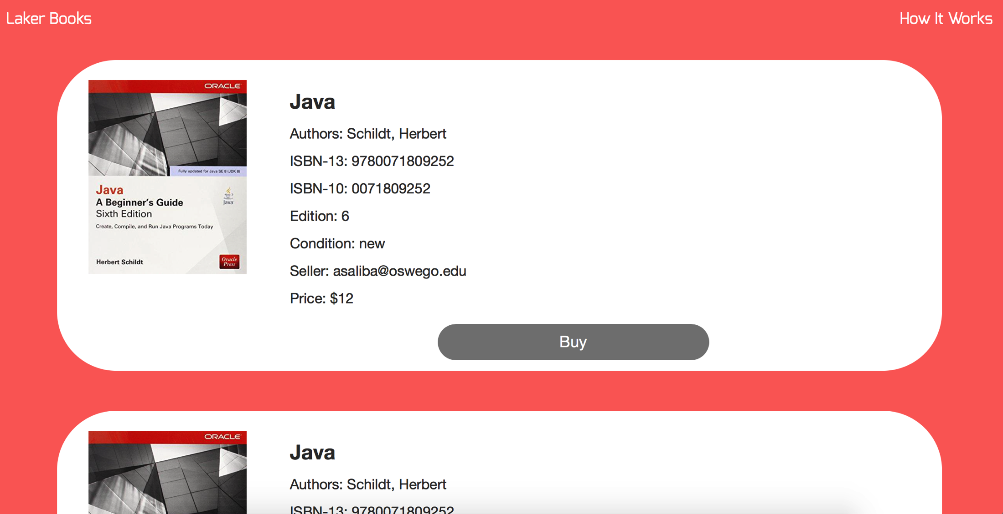
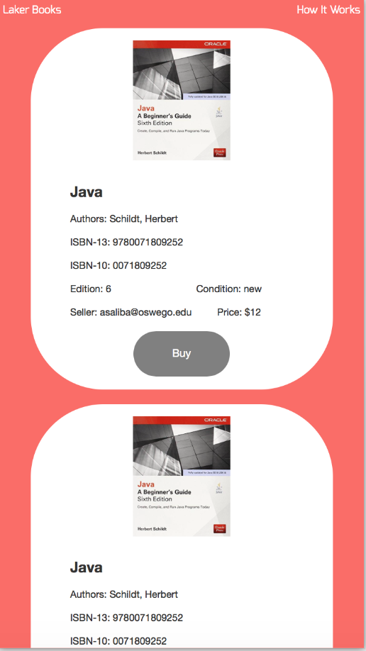
Computer
Mobile Device

Slide 6
DEMO

